Slide 1

AUTOMATED ROAD DAMAGE DETECTION AND CLASSIFICATION SYSTEM USING CONVOLUTIONAL NEURAL NETWORKS
Name: Chanda M. Chimfwembe
Student No: 202001198
Course: ICT431 Capstone Project (Presentation Stage)
Programme: Bachelor of Computer Science
Supervisor: Dr. B. Halubanza

Slide 2
CONTENT
1. INTRODUCTION
2. LITEREATURE REVIEW
3. METHODOLOGY
4. PROJECT MANAGEMENT
5. CONCLUSION

Slide 3
INTRODUCTION
1. 1 Introduction
1.1.1 Background and Summary
Road infrastructure plays a pivotal role in facilitating transportation, enabling the seamless movement of people and goods (Haghani et al., 2022). However, roads are susceptible to environmental and usage-related factors, including severe weather conditions, heavy traffic, and natural wear and tear, all contributing to road deterioration (Huang et al., 2023). Diagnosing road deterioration is crucial for sustaining the economic vitality of Zambia, ensuring the well-being of the local population, and advancing secure and adequate transportation.
Traditionally, visual inspections conducted by trained personnel over extended periods have been the primary method for assessing road deterioration. However, this approach is time-consuming, expensive, and subjective, depending on the expertise of the inspector (Zhang et al., 2021). In response to these challenges, automated techniques for identifying road damage, leveraging technologies such as remote sensing, computer vision, and machine learning, have gained attention. These technologies provide an opportunity to revolutionize road maintenance and repair in Zambia (Zhang et al., 2022).
The development of an Automated Road Damage Detection and Classification System using Convolutional Neural Networks specifically tailored for Zambia addresses the country's unique challenges. Tailoring the system to local conditions, such as climate, road materials, and traffic patterns, ensures its effectiveness in Zambia's diverse environment. This customization enhances the system's adaptability and relevance to Zambia's road infrastructure.

Slide 4
INTRODUCTION
1.1.2 Challenges in Zambian Road Infrastructure
Zambia's diverse road network poses challenges for maintenance, requiring efficient and proactive solutions. Economic vitality, transportation efficiency, and safety hinge on timely detection of road damage. An automated system can significantly reduce economic losses, ensuring secure transportation and contributing to environmental sustainability.
1.1.3 Types of Damages of Roads in the Zambian Context
Classifying road damage is essential for prioritizing maintenance. Various damages like cracks, rutting, roughness, and potholes have unique implications for the environment and traffic.
Cracks: Minor surface damage due to poor-quality materials, inadequate pavement thickness, and subsidence.
Rutting: Depressions caused by large loads and poor drainage.
Roughness: Irregular surfaces due to factors like lack of aggregate purity and poor adhesion of surface treatment.
Potholes: Small to medium-sized holes caused by traffic wear and inadequate maintenance.

Slide 5
1.2 Problem Statement
Despite the vital role of road infrastructure in Zambia's development, current manual methods for road damage detection pose challenges. Resource limitations, subjectivity, economic impact, safety concerns, and environmental implications highlight the need for an advanced solution.
Challenges:
Resource Limitations: Manual inspections struggle to cover vast road networks promptly.
Subjectivity: Inspections rely on expertise, introducing inconsistency in damage identification.
Economic Impact: Undetected damage leads to increased repair costs, affecting regional vitality.
Safety Concerns: Damaged roads jeopardize safety and accessibility to essential services.
Environmental Impact: Inefficient detection contributes to a higher environmental footprint.
Addressing these challenges requires an advanced, automated road damage detection system like Convolutional Neural Networks (CNNs) tailored to Zambia's conditions, streamlining detection, enhancing accuracy, and optimizing resource allocation.

Slide 6
1.3 Aim
The primary aim of this study is to design, develop, and implement an Automated Road Damage Detection and Classification System tailored for Zambia, utilizing Convolutional Neural Networks (CNNs). This system aims to address the inherent challenges in the current manual inspection methods and introduce a more efficient, accurate, and technology-driven approach to road infrastructure management.

Slide 7
1.4 Objectives
The goals of the suggested project are as follows:
To identify the challenges faced by road damages
Gather and clean the dataset.
To train the model, prepose and select the ideal model, and validate the chosen model
To develop and integrate the model with a mobile app.

Slide 8
2. LITERATURE REVIEW
2.1 Review of Existing/Current System:
2.1.1 Road Damage Detection Using Image Processing:
Numerous methods have been explored for analysing road properties, ranging from in-vehicle cameras to image processing and machine learning approaches. Traditional methods, such as crack detection using image processing and machine learning, have paved the way for more advanced techniques like deep neural networks. Notable studies like Crack Net focus on predicting class scores for pixels, while others delve into classifying damage types. However, practical models for municipalities must distinguish and detect various road damage types. Recent studies emphasize end-to-end deep learning for superior performance in road damage detection.

Slide 9
2. Cont…
2.1.2 Road Damage Detection Using Smartphones:
While specialized vehicles for road inspection can be expensive, smartphones have emerged as cost-effective alternatives. Smartphone sensors have been utilized for measuring road flatness, visualizing potholes on maps, and detecting road surface damage. Surprisingly, there is a lack of research on processing road images acquired by smartphones for road damage detection. This chapter demonstrates the feasibility of using end-to-end deep learning for processing such images.

Slide 10
2. Cont…
2.1.3 Object Detection System:
Several object detection methods, such as R-CNN, Fast R-CNN, and Faster R-CNN, have been employed, each with its advantages and limitations. Faster R-CNN improves accuracy and execution speed, but computational load remains a concern. YOLO (You Only Look Once) offers high mean average precision (mAP) and speed, predicting regions and classes in a single pass. SSD (Single Shot MultiBox Detector) is another framework that utilizes multiscale convolutional bounding box outputs, ensuring speed and accuracy. The chapter discusses the adoption of SSD as a training algorithm for processing images from a mobile terminal. The literature review underscores the evolution of road damage detection methods, emphasizing the transition to deep learning techniques and the potential of smartphones in this domain. It also highlights the need for standardized datasets and the importance of selecting suitable object detection frameworks for efficient processing.

Slide 11
2. 2 Comparisons of Reviewed Systems
System (Research Paper) | Road damage detection using image processing | Road damage detection using smartphones | Proposed System
System Task | Predicting | Predicting | Predicting & Classifications
Implementation Language(s) | Python | Not Specified | Python & Java (Mobile App)
Model Type | Deep Neural Networks | Machine Learning | Deep Neural Network
Dataset | Road photos | Road photos | Road surface images
Application Type | Web App | Mobile App | Mobile App
Data Requirement | High | Medium | Medium
Available in Zambia | NO | NO | YES
Real Time | NO | YES | YES
In comparing existing systems for road damage detection, the research paper utilizes deep neural networks for predicting road damage based on images. Another approach, focusing on image processing and machine learning, predicts road damage using a traditional method. In contrast, a system leveraging smartphones employs machine learning for predicting and utilizes a mobile app for real-time detection. The proposed system combines the strengths of deep neural networks and machine learning for both prediction and classification tasks. While existing systems often demand high-quality datasets and lack real-time capabilities, the proposed system addresses these limitations, particularly emphasizing its adaptability to the Zambian context with the availability of relevant data and real-time functionality through a mobile app. The use of Python for the research paper and the proposed system ensures flexibility, while the mobile app introduces Java for extended application reach. This comparative analysis underscores the evolution toward deep learning techniques and highlights the potential of smartphones for efficient and real-time road damage detection and classification.

Slide 12
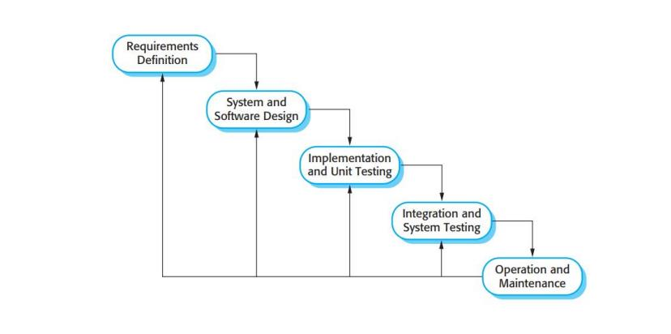
3. RESEARCH METHODOLOGY
Waterfall Model
This is the process that will be utilized to construct the proposed system. The initial software development process model was drawn from more broad system engineering methods. The 'waterfall model' or software life cycle is named after the way the phases flow from one to the next. In essence, the waterfall model is a plan-driven process since it requires you to plan and schedule all of the process tasks before you begin working on them. (Sommerville, 2011).
Development of Road Damage Detection and Classification System.
Requirements analysis and definition, at this stage we gathered all the requirements needed to build the system and they have been well documented. All the constraints, services and goals are created with the consultation of the system users.
System and software design, since this is only a software application and no hardware is needed, this means that during the system design process we shall only allocate the requirements to the software system by establishing an overall system architecture. At this stage we shall strike a balance between requirements that conflict with each other for example maintainability and performance, within our implementation environment.
Implementation and unit testing, at this stage our completed design will be translated into program code but inform of a set of programs or program units. During this stage we shall use anaconda and the python language for training and testing the machine learning classifier. Then we shall test each unit to see if it meets the specification. At this stage we shall test the mobile app’s functionalities.
Integration and system testing, at this stage the individual program units that we tested for example our classifier will be integrated into one unit and tested as complete system, at this stage the Classifier and the mobile app will be tested as a single unit. After a successful testing it shall be delivered to the customer.
Operation and maintenance, at this stage the system will be put through practical use, and then it shall undergo maintenance which will involve correcting errors which will be discovered that could not be seen earlier on, then improving the system.

Slide 13
3.1 Justification of Selected Methodology
The Waterfall Model is the most basic SDLC approach for software development. A sequential model is exemplified by this model. As a result, it's also known as a linear sequential life cycle model (GeeksforGeeks, 2020). The waterfall model is picked as the main methodology because it suits this proposed system very well in that, the proposed system is well documented and will have each phase clearly defined before the building of the system even begins.
Our system development process has two parts which is research on the classifiers and building the mobile app, since the waterfall model is done in phases and makes sure each phase is completed before going to the next phase it suits this system because the evaluating, Pre-processing, training and testing of our classifier has to be done in steps and each phase must be completed fully for us to go to the next phase, then after the research phase is completed fully we then have to build the mobile app as our next phase in order for it to work with the classifier. Building the mobile app will also be done in phases as well as well as having all the requirements fully documented and as clear as possible.
The tools that will be used are well understood, this point works well under the waterfall model. Since the project is a 2-semester long project it makes it short as compared to most software projects, the proposed system won’t be expensive as well which also fits the waterfall model methodology.

Slide 14
4. 1 Budget Calculating budget total: Total wage for the project is: (K5000 for 8 months) / 5 = K 8,000 The total budget of the project is 8,000 + 12,000 + (60 ∗ 8) + (450 ∗ 8) + 1000 = 𝐾 25,080 The project duration is 8 months which we break down to 4 months in each semester. The project is further broken down using the table below showing each activity and expenditure.
NAME | Amount (ZMK)
Salary | 5000/month
Computer (with required software) | 12000
Power | 60/month
Internet | 450/month
Other Costs | 1000
4. PROJECT MANAGEMNT

Slide 15
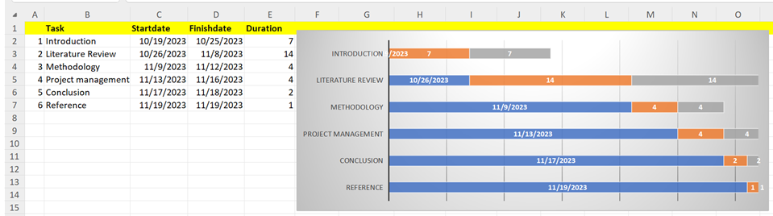
4.2 Scheduling and Work plan Scheduling is the process of organizing, controlling and optimizing work and workloads in a production or manufacturing process. Scheduling is used to allocate resources and processes. 4.3 Summary This chapter delves into the critical components of risk analysis and effort costing, integral for assessing potential project risks and estimating the necessary resources. The focus on risk analysis is to identify and proactively mitigate challenges that may arise during the project. Simultaneously, effort costing is utilized to determine the time and resources required for the timely completion of the Road Damage Detection and Classification system. The incorporation of the COCOMO model enhances the precision of estimating software costs, offering valuable insights for effective budgeting and resource allocation. Furthermore, the use of a Gantt chart provides a visual roadmap, aiding in project timeline planning and detailing key development stages at specific intervals. Together, these tools contribute to efficient project management, ensuring a structured approach for the successful delivery of the Road Damage Detection and Classification project.
4. Cont…

Slide 16
5. Summary/Conclusion
Chapter 5 provides a thorough exploration of the pivotal aspects of risk analysis and effort costing, essential components for effective project planning in the Real-Time Detection and Classification of Road Damage. The chapter leverages the COCOMO model to estimate software costs, offering valuable insights into budgeting and resource allocation. Additionally, a Gantt chart is employed to meticulously outline the project timeline, delineating specific development stages at predefined intervals.
In summary, this chapter serves as a comprehensive guide within the project proposal for the development of a Real-Time Road Damage Detection and Classification System using Convolutional Neural Networks. It encompasses the project's significance, the associated challenges, a review of existing methods, the proposed system's architecture, the chosen software development methodology, project management specifics, and the crucial considerations of risk analysis and effort costing.
5.1 Research Contributions
The envisioned Road Damage Detection and Classification System make substantial contributions to the field of infrastructure maintenance. It empowers non-specialist users, including road maintenance personnel, to efficiently detect and classify road damages in real-time. This system facilitates informed decision-making in matters of road management, resource allocation, and financial planning for maintenance activities. Its impact is particularly significant in regions where access to road infrastructure specialists may be limited, showcasing widespread applicability through the integration of Convolutional Neural Networks for precise and swift detection of road damages.

Slide 17
5.2 Reference
GeeksforGeeks. (2020, August 5). Waterfall Model in Software Development. Retrieved from https://www.geeksforgeeks.org/waterfall-model/Geiger, A., Lenz, P., Stiller, C. & Urtasun, R. (2013), Vision meets robotics: the KITTI dataset, The International Journal of Robotics Research, 32(11), 1231–37.
Sommerville, I., 2011. Software engineering. 9th ed. s.l.: Addison-Wesley /Pearson.
Tutorialspoint. (2022, July 12). Waterfall Model in SDLC. Retrieved from https://www.tutorialspoint.com/adaptive_software_development/sdlc_waterfall_model.html
Zhang, A., Wang, K. C., Li, B., Yang, E., Dai, X., Peng, Y., Fei, Y., Liu, Y., Li, J. Q. & Chen, C. (2017), Automated pixel-level pavement crack detection on 3D asphalt surfaces using a deep-learning network, Computer-Aided Civil and Infrastructure Engineering, 32(10), 805–19.
Zhang, L., Yang, F., Lv Y, et al. Road Crack Detection Using Deep Convolutional Neural Network with Multiscale Analysis. Sensors, 2022;22(10): 3737.
Zhang, Z, Kang J, Li P, et al. Road surface damage detection based on the improved deep convolutional neural network algorithm. Journal of Advanced Transportation, 2021;2021: 1-10.

Slide 18
End, thanks!!!

